Slide 1
Unity Game Project:
Uncivil Arboretum
From CCIT 4080B-CL07 (Group 1):
Lam Chi (20156673)
Lam Chun Ngok (20156319)
Chung Hing Yi (20143194)
Ho Yee Ching (20144867)

Slide 2
Contents Page
Executive summary
Introduction
Background
Problems
Purpose of the project
The Team
Member Introduction
Jobs distributions
The Project
Initiation & Planning
Game Making
Game Body & demonstration
AR Part
Design
Others
Future Development & Limitation
Reflection

Slide 3
01
Executive Summary

Slide 4

Executive Summary
Why the project Uncivil Arboretum get started ?
People dislike those ‘uncivil’ behaviours .(e.g. Too noisy)
Let citizens have fun and think about those behaviours.
How we finished this Unity project from 0 to 100?
Initiation of the game
Designing different objects
Implementation
What is the benefit Uncivil Arboretum can give?
Enjoyment (Can spend your time in game).
Reflection about the uncivil activities in real life.
What is the features of Uncivil Arboretum?
Original characters that are meaningful.
Gamers are ‘villians’.

Slide 5
02
Introduction
Background & Problems & Purposes

Slide 6
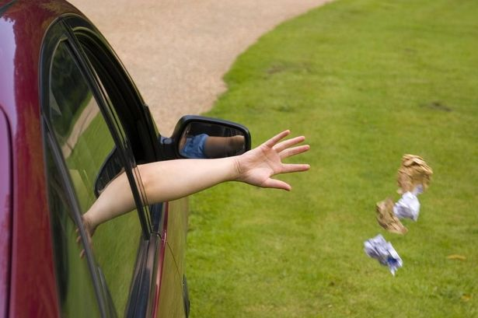
Background
Have you ever saw :
Littering on the street ?

Slide 7
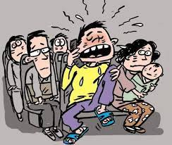
Background
Have you ever saw :
Talking loudly on a bus ?

Slide 8
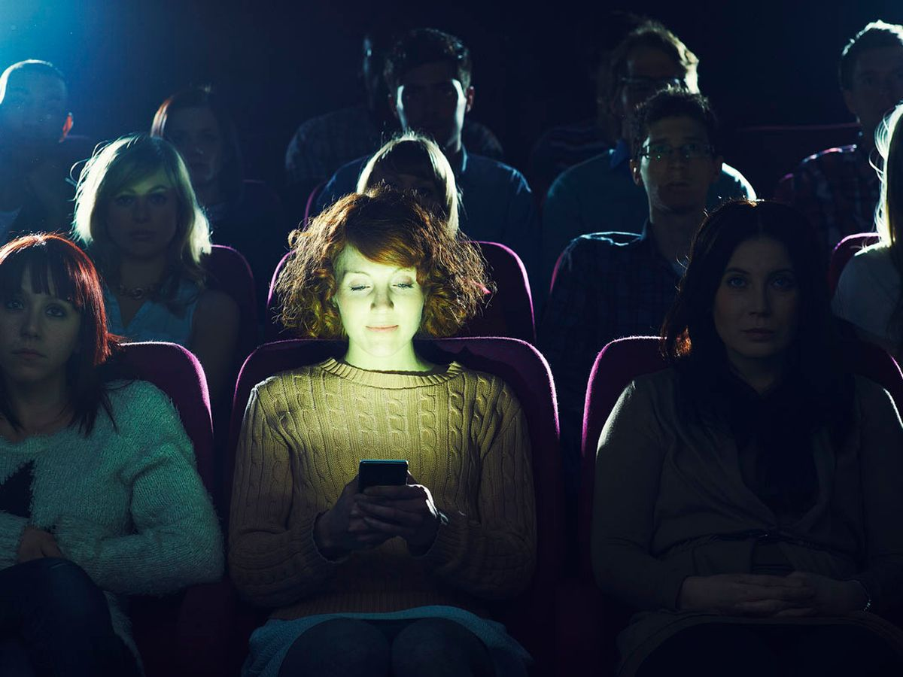
Background
Have you ever saw :
Using phone in the theatre ?

Slide 9
Background
‘Uncivil’ behaviours = Being rude/impolite

Slide 10


Background
Citizens dislike those actions:
Cannot revenge on them as they are moral.
May disappointed and give up on being polite.
Citizens that act rudely:
Cannot realize their own mistakes.
Cause vicious circle

Slide 11
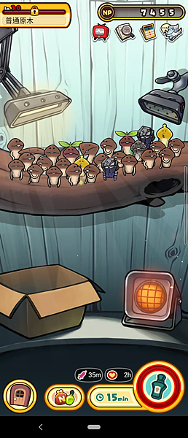
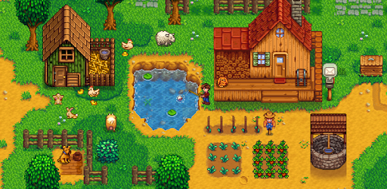
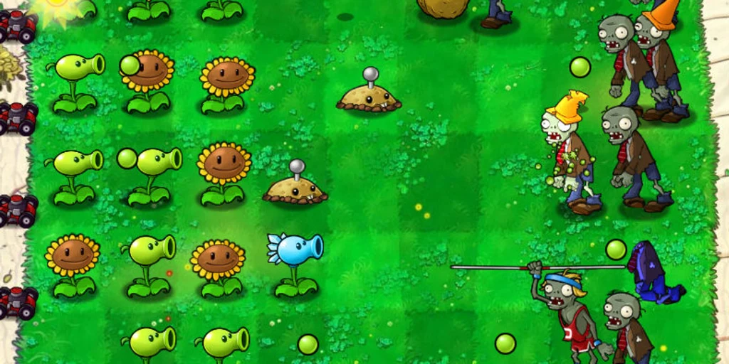
Background
Inspiration
Planting/ Idle games online
Mushroom Garden series
Simulation Game
Plants VS Zombies (PVZ)

Slide 12

Problems
How can we stop the vicious circle?
How can a game helps this situation?
What should be solved in this case?
How can a game related to this theme be funny?
What type of game we can make?
etc.

Slide 13


Problems

Slide 14
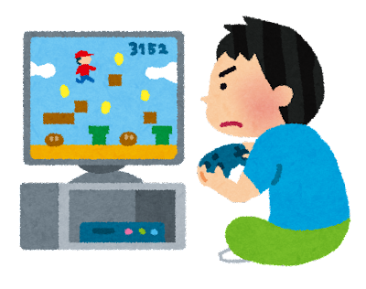
Purpose
For moral citizens:
Provide entertainment.
Release stress.
For uncivil citizens:
Reflect themselves.
Reduce the initiatives to behave bad in the public.
Reasons for selecting games as the media
Can create more original objects.
Wider range of users.
Can works well independently
Comparing to the functions for
specific item. (e.g. Parking Lot)

Slide 15
03
The Team

Slide 16

Member Introduction
Background Information:
Most of the members have never designed a game before.
Students in SPACE AEng Year 2 (Computer Science Theme)
Do not know any Augmented Reality (AR) related technologies.
Can write Python, Java codes.
Some of the members are good at design & art.

Slide 17
Job Distribution
Lam Chi (Group Leader) | Chung Hing Yi
Main Game Body Programming Video editing Artwork Logbook writing Graphs making | Artwork design Integration of different game parts Main Game Body Programming AR Game developing Logbook writing
Lam Chun Ngok | Ho Yee Ching
Menu System designing Setting and map page designing Logbook writing | The design and develop of the AR Game Part Documentation Logbook writing

Slide 18
04
The Project

Slide 19
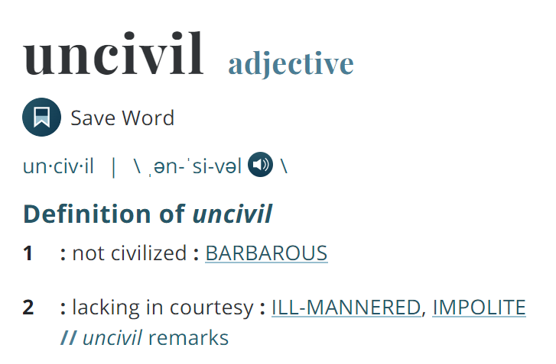
Initiation & Planning
How is the name ‘Uncivil Arboretum’ comes out?

Slide 20
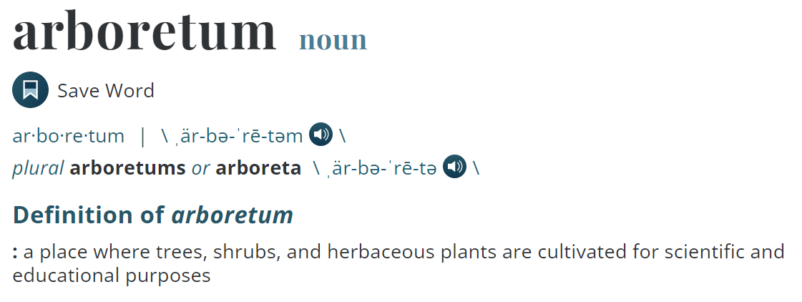
Initiation & Planning
How is the name ‘Uncivil Arboretum’ comes out?

Slide 21
Initiation & Planning
How is the name ‘Uncivil Arboretum’ comes out?
Words can be related when mention about ‘Plants’:
Natural = not civilized = Uncivil
Fresh
Healthy
Clean
Environment
Benefit to human

Slide 22


Initiation & Planning
How is the name ‘Uncivil Arboretum’ comes out?
What if, the plants are actually ‘uncivil’?
Have their emotions and movement.
Being rude to others.

Slide 23
Initiation & Planning
Background Story:
In 2422, people on Earth have civilized everywhere on Earth
Plants become extinct.
However, A botanist has found some seeds from the fridge 2000 years ago.
He realized that plants cannot survive in 2422 as they cannot protect themselves.
He added the ‘Uncivil’ genes to the plants, and the plants start moving and act like uncivil human.
The botanist decides to help the plants, by keep planting them and get ‘Angry Point’ (AP) to upgrade the devices.

Slide 24

Initiation & Planning
Plants:
Take time to grow up
If planted in the pot for too long, it will turn into a good carrot which gives 0 AP and become useless.
The plants can be turned into AP. Gaining AP can upgrade the facilities and unlock new simulation background (New background and plants)

Slide 25
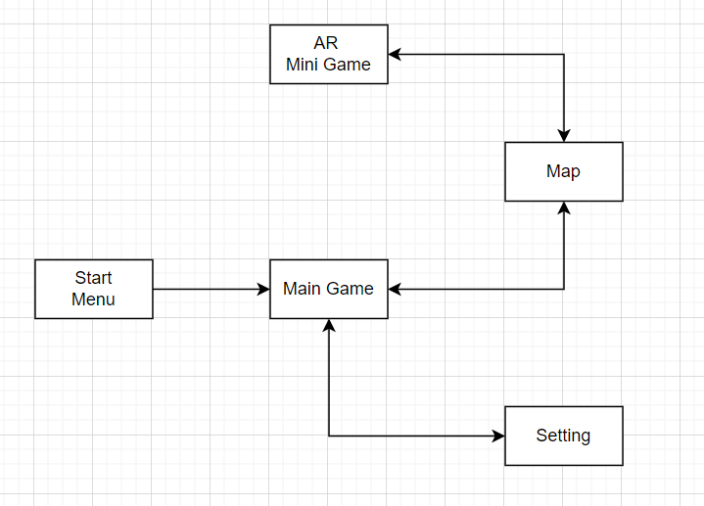
Initiation & Planning
App Plan

Slide 26
Game Making
The making of the game have been divided into 4 parts:
Main Game Body
AR Game
Designing the scenes
Menu

Slide 27
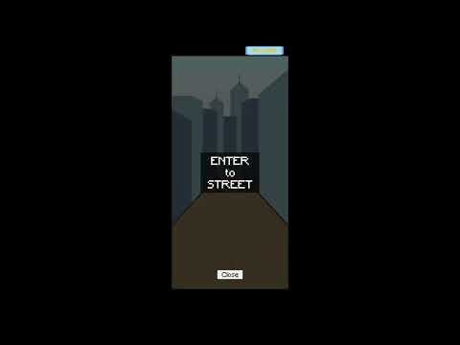
Game Making
Video Demonstration (Speed up):

Slide 28
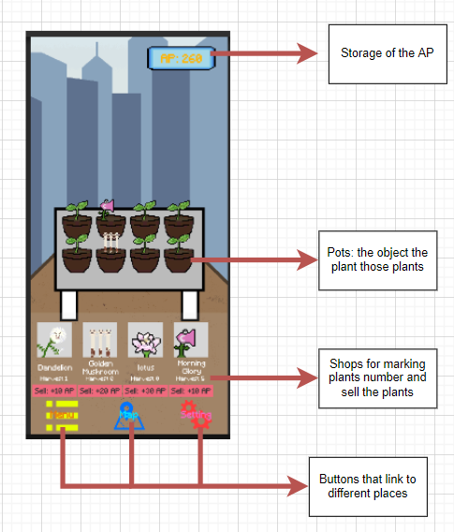
Game Making - Game Body
Interface :

Slide 29



Game Making - Game Body
Plants:
Seeds → Sprout → Plant → Plant (Died)

Slide 30
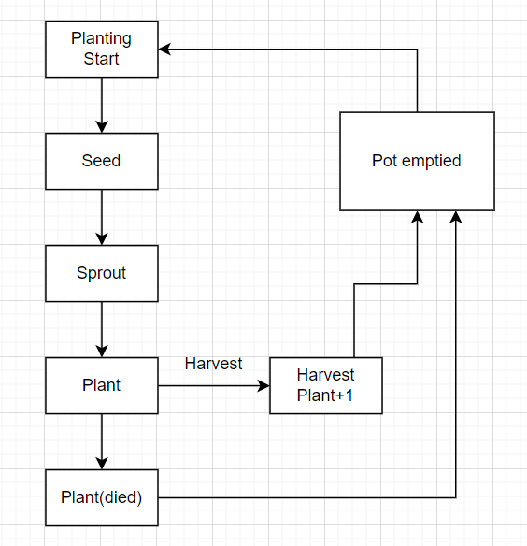
Game Making - Game Body
Plants:

Slide 31
Game Making - Game Body
Resources:
Plants
Showing the number of different plants.
Their probabilities to get in the ‘Plant’ stage.
Their exchange ratio to AP.
Angry Point (AP)
Main resources for different upgrades.
Can use to unlock maps.
Gain when selling plants.

Slide 32
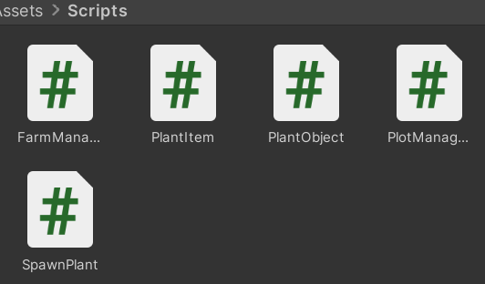
Game Making - Game Body
Development:
Set the pots and the plants as prefabs
Writing C# scripts to control the plants
Set up new object type ‘Plant’ to store all data related to the plants.

Slide 33
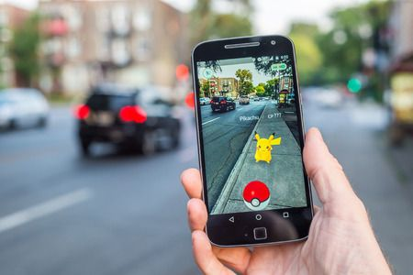
Game Making - AR Part
What is Augmented Reality (AR) ?
Interactive experience of a real-world environment
Doing real things in the virtual phone screen.

Slide 34
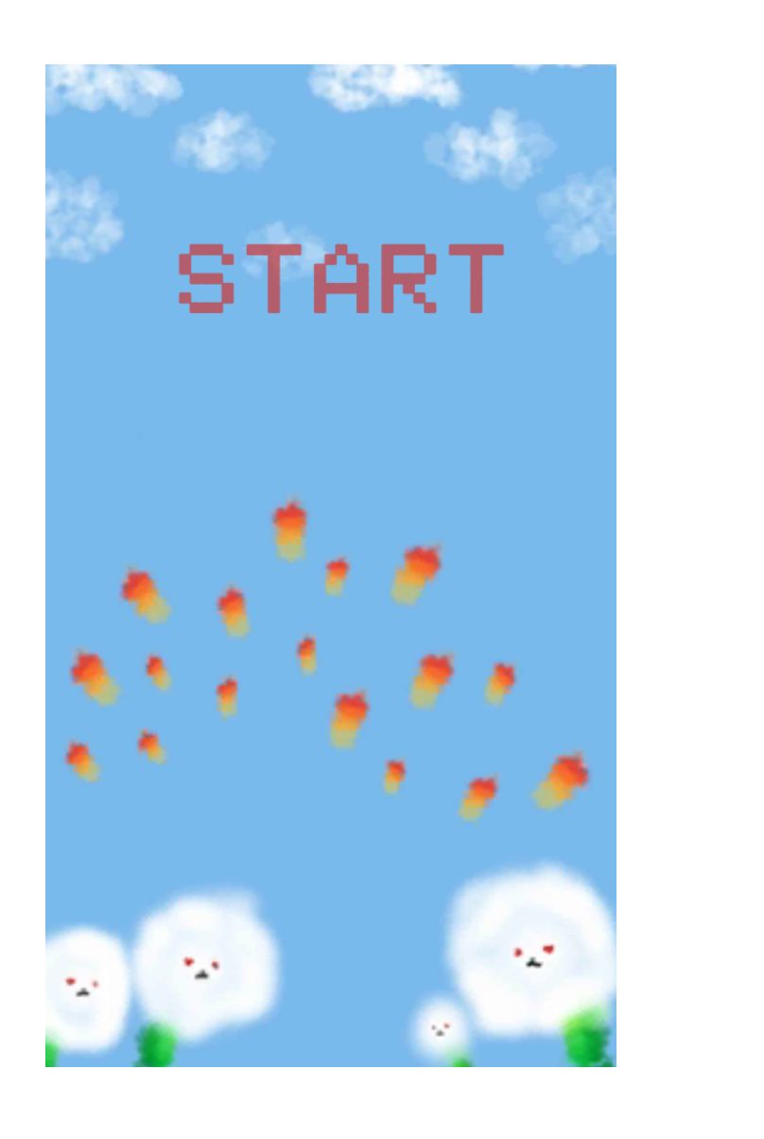
Game Making - AR Part
What is the game about?
An AR shooting game
Player gains point when shoot the 3D objects
Passing this game to unlock the new map

Slide 35
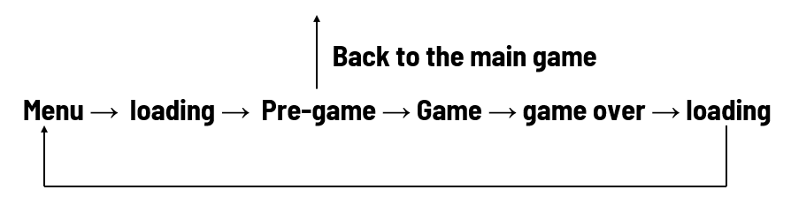
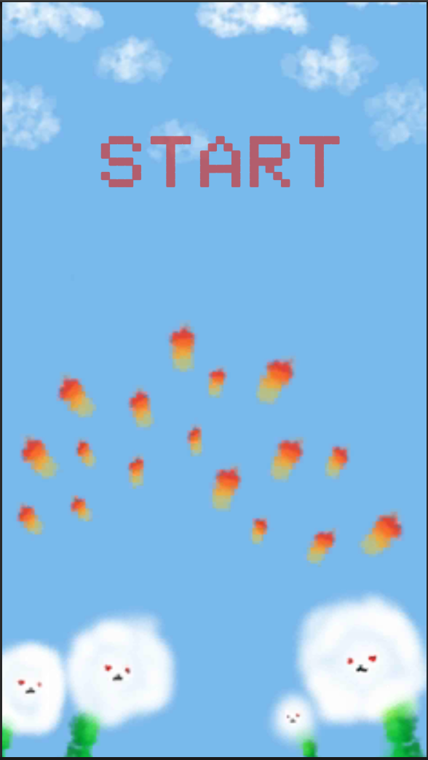
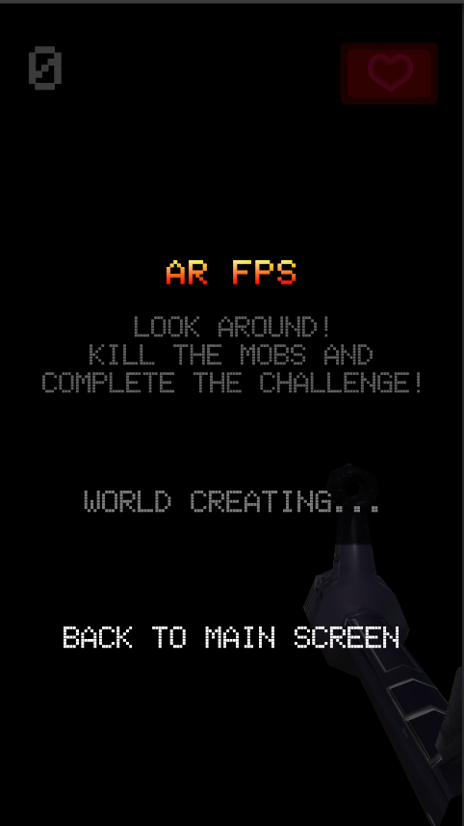
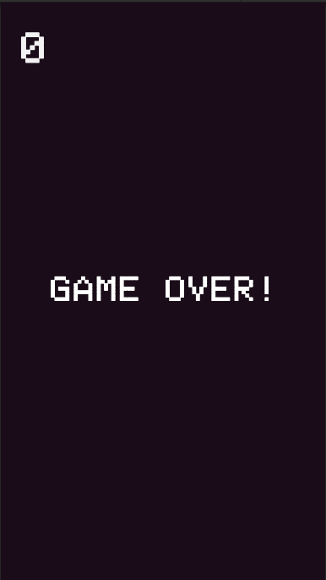
Game Making - AR Part
The loop of the scenes in ar shooter:

Slide 36
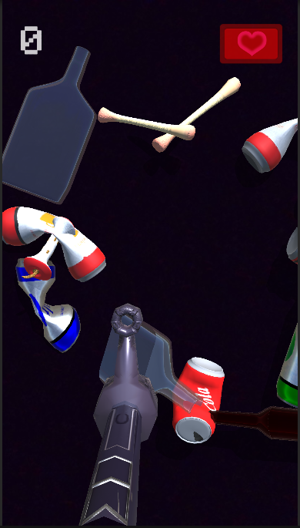
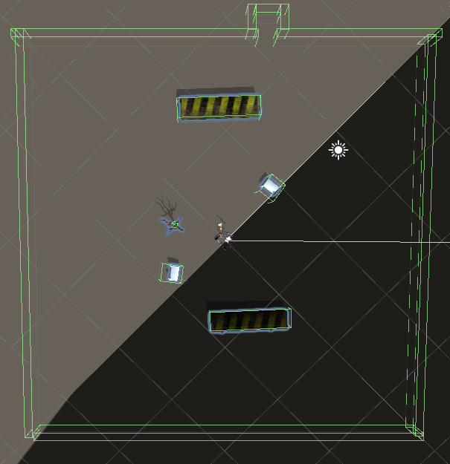
Game Making - AR Part
Setting & User interface:
Invisible wall
Barriers
Score
Health Bar
Gun

Slide 37
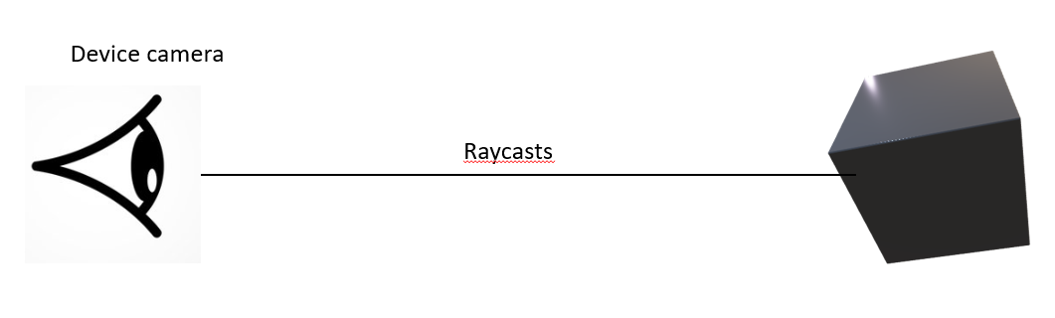
Game Making - AR Part
Raycast:
Device camera acts as our eyes
Return a boolean value once its hit the object
The information of the object would be given after hitting the object
(e.g. The distance between origin and hitted object)

Slide 38
Game Making - AR Part
Player & Gun:
Damage per shot
Cool down time after shot
The range of the gun
Player Health value
Stop chasing after hitting a object

Slide 39
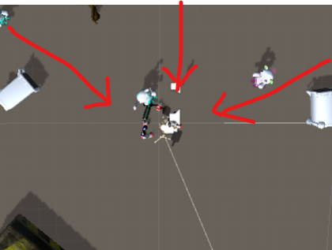
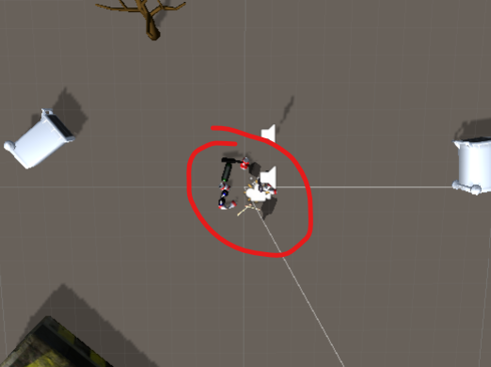
Game Making - AR Part
Enemy:
3 different types of 3D enemy
Different spawning time
Enemies move toward to player
When enemy step into the ‘PlayerDamageZone’
Start Attacking until players death

Slide 40
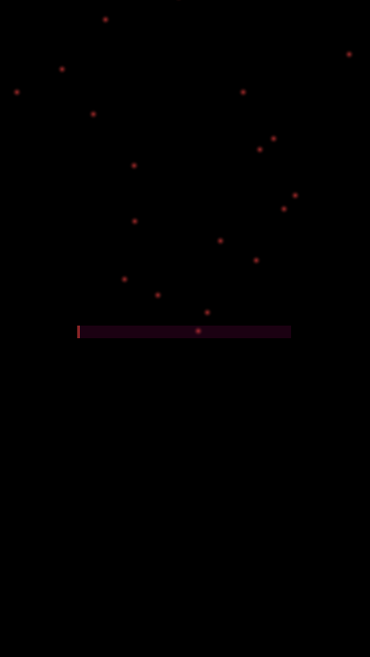
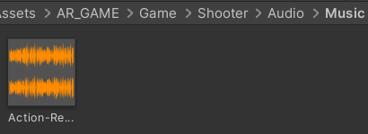
Game Making - AR Part
Others features & special things:
Sound effects
Background music
Animation
Particles
Using Collider in 3D objects

Slide 41
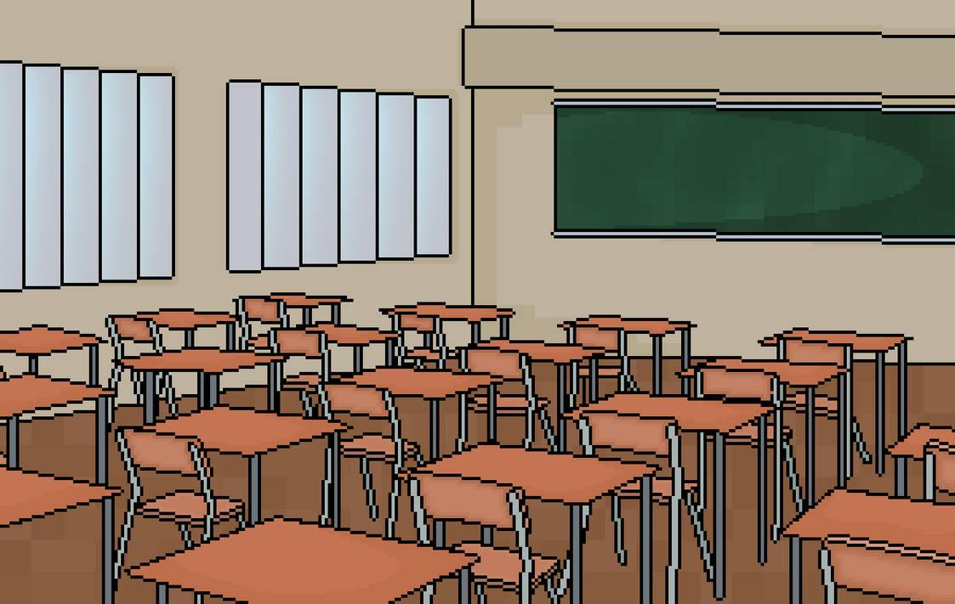
Game Making - Design
The style of the whole project : Pixel
Easy to handle
Simplistic
Good to view

Slide 42
Game Making - Design
Scenes in the main game :
Street
School
Cinema
Immerse players to the game
The scenes are in daily life.

Slide 43

Game Making - Design
The plants included in this game and what they mean:
Street view:
Morning Glory
Representing people who make noise around the world.
Dandelion
Representing people who littering all around

Slide 44


Game Making - Design
The plants included in this game and what they mean:
Street view:
Golden Mushroom
Representing people who block the road by standing in one line.
Garden Nicotiana
Representing people who smoke while walking on the road

Slide 45


Game Making - Design
The plants included in this game and what they mean:
Cinema view:
Bad rose
Representing people who hit others’ chair.
Yam
Representing people who block others’ sight when watching movies.

Slide 46


Game Making - Design
The plants included in this game and what they mean:
Cinema view:
Lotus
Representing people who are smelly or add too many perfumes.
Light Carrot
Representing people who using shining devices in the theatre. (e.g. using mobile phone)

Slide 47
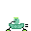

Game Making - Design
The plants included in this game and what they mean:
School view:
Pea - rider
Representing free-riders.
Seaweed
Representing people who always want to make friend with others, and it is a fake friend itself .

Slide 48


Game Making - Design
The plants included in this game and what they mean:
School view:
Grapes
Representing a big group of people that will isolate the others and form their own groups.
Rose
Representing people who grow up their thorn to protect themselves.

Slide 49
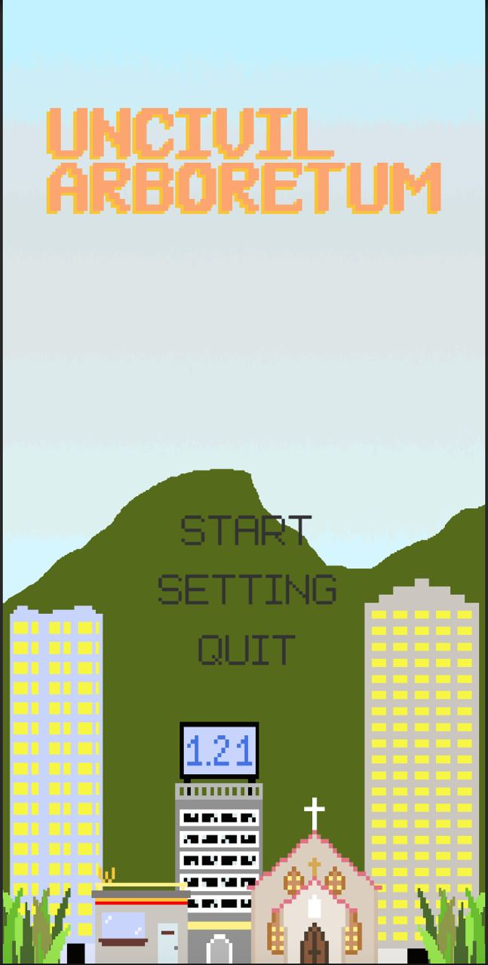
Game Making - Others
Menu
With three buttons going to different places:
START : to the main game.
SETTING : to the setting.
QUIT : leave the game
Use simplistic background

Slide 50
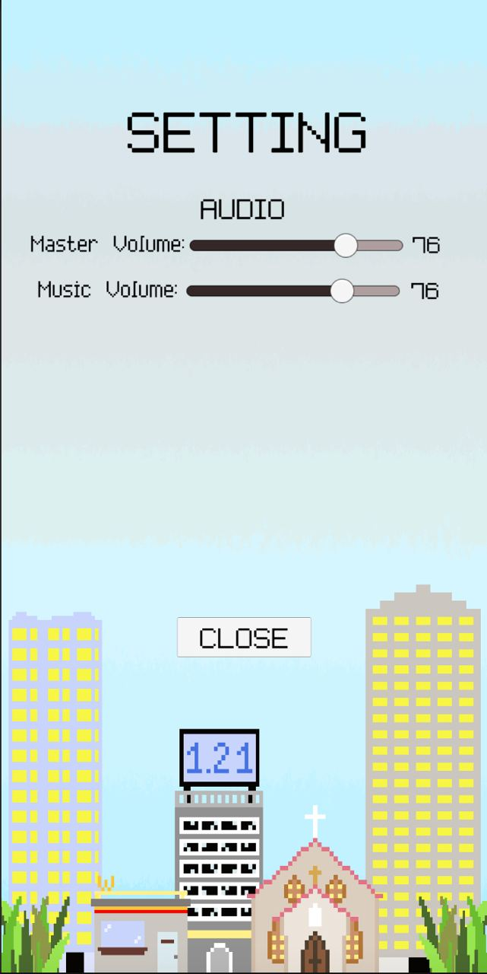
Game Making - Menu
Setting
Use to adjust the volume of the game.
Close button included.

Slide 51
05
Future Development
& Limitation

Slide 52
Future Development
Gameplay
More stages and different characters can be planted.
Online ranking system for different plants.
New systems/gameplay can be added:
Idle Game - AP can gain automatically with plants , its efficiency can be advanced by adding more plants of the same type.
Upgrade system - The probability of getting plants with higher AP can be changed by upgrading the equipments in the same scene.
Turn all plant sprites into animations instead of pictures.

Slide 53
Future Development
Gameplay
More user-friendly designs can be added
‘One click harvest all’ functions.
Scroll bar for the shop item for users to view more plants.
Illustrated guide for different plants.
Real time can be shown in the top of the game.
More props can be added (e.g. props to increase the planting speed / or the rarity.)

Slide 54
Future Development
Gameplay
A tutorial can be added to guide the new players
More AR features can be added to different places in the game.
Decoration
Different things in the background can be added
Different message boxes can be add to describe the use of each object.

Slide 55

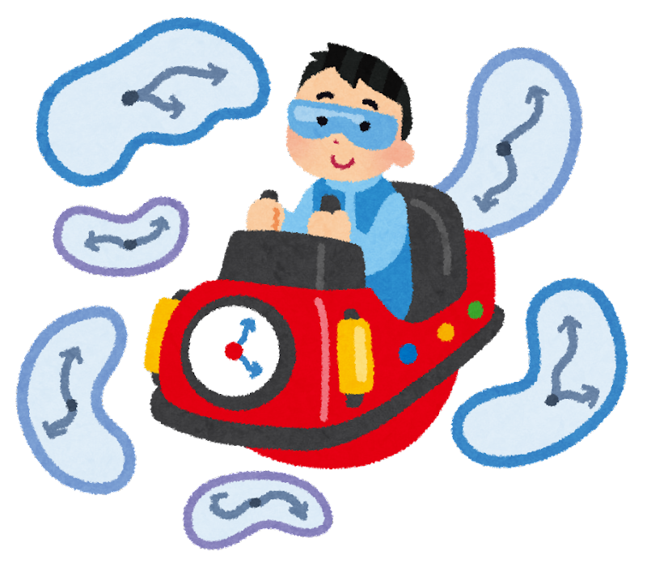
Limitation
Time: As all of the team members are Year 2 students, we do not many extra time for the project.

Slide 56

Limitation
Technology level: as we are not familiar with the game engine Unity, programming language C# and the game developing process, we spend many time to discuss how to finish the project.

Slide 57

Limitation
Pandemic : the rise of pandemic disrupted our schedules for many times. It is inconvenient to work under the pandemic.

Slide 58

Limitation
Originality: As we seek for high originality, we spent many times on designing the game structures and the in-game images.

Slide 59
06
Reflection

Slide 60
Reflection
Lam Chi:
In my opinion, I really learnt a lot in this project. I can use Unity to make game skillful now, and I have learnt how to solve the problems in the given time and resources, which is useful as everyone need to advance their problem solving skills.
As the person in charge of the main programming parts,I think that having a clear logical mind is important, as you have to know what is the output you want and what you are doing all the time, or else you will get lost easily.
Finally, I really appreciate my group mates, they are hard working all the time, we spent many days and nights to debugging and building this project, thanks a lot.

Slide 61
Reflection
Chung Hing Yi
In this project, I got inspired by various tutorial videos. It brings me to understand Unity better, like the build process and some methods. The project provided a chance to apply the concept we learned.
As I am the bridge to connect the works, I have to get known in different parts done by our groupmates. Having a clear mind to read the scripts is vital in this process, as it is easy to get stuck while merging.
Last but not least, I want to say thanks to my group mates. It was tough to handle the problem for this long period. Thanks for their hardworking and perseverance.

Slide 62
Reflection
Ho Yee Ching
I have also learned a lot from this project. I am a beginner at programming. Also, It was my first time developing a game. I did a lot of research and watched many tutorials on the internet to learn how to build a game. I often check and find the solution for the bugs from some online forums.
Once I know I would be handling the AR part, I was pretty nervous. As I mentioned before, I have zero knowledge in developing the game, not even an AR game. Likely, I found some useful online tutorials. Therefore, we could find some similar places in the game.
Last but not least, I would like to give a big hand to my group mates. Although all of us are very busy with other subjects, they are very willing to help each other or even have a meeting at midnight.

Slide 63
Reflection
Lam Chun Ngok
I have learnt a lot from this project. At first, i thought creating a game is easy and it only requires good programming skills. However, after finished this project, i realised the importance of implementing the game, the background of the game and also others important factors. My part is quite easy to deal with. Yet, i have learnt many new knowledge in Unity and it will totally help me to develop my future career more successfully.
At last, i would like to give credits to my teammate, without the efforts they put on it, it would not have been possible to complete this gorgeous project.

Slide 64
THE END

